Slide 1
Parallelizing Neural Nets
Christian Followell

Slide 2
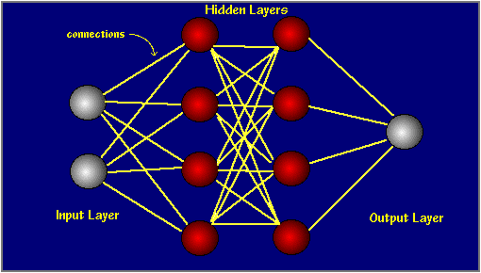
What is a Neural Net?
Set of weights and activation functions that allow you to generate output from a given input
Simple case is classification of input
Given sepal length, sepal width, petal length, and petal width, predict flow type

Slide 3
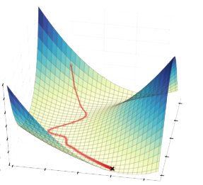
How to Train?
Initialize Weights
Use back propagation with gradient descent
Gradient descent can occur for all samples, stochastically, or in batches

Slide 4
What Can be Parallelized?
Batch gradient descent
Scatter samples to be used in calculation to different processes
Compute weight changes for each sample
Sum local weight changes for each process
Allreduce (sum) the local weight changes
Run different models in parallel in order to determine the most desirable hyperparameters

Slide 5
Distributed Memory Parallelization
Run using MPI4PY
Works very well as long each process belongs to only one processor
Batch size was 64, so that is probably why performance gain deteriorates

Slide 6
Distributed Memory Parallelization
When each process does not get its own processor, performance rapidly deteriorates to worse than single process levels

Slide 7
Ideas/Experiments I Still Need to Implement

Slide 8
Shared Memory Parallelization for Batch Gradient Descent
Python only allows one thread to execute at a time due to the global interpreter lock (GIL), so this a little tricky
Possible to use shared memory across processes through the multiprocessing library
The basic idea is to use to put the samples in a queue and have processes take samples once they have computed the weight updates for their prior sample
Weight updates will be summed locally and when the queue is empty each process can write to the shared memory weights under a mutex

Slide 9
Larger Datasets
Iris is a small dataset and does not have enough samples to continue increasing batch size
Larger dataset is needed if isoefficiency curves are to be examined
Having a larger hidden layer = more computation would help to reduce noise as well and might also be a good scaling experiment

Slide 10
Explore Different Batch Sizes
Change batch size but fix the amount of total work by reducing / increasing number of iterations
This will help to determine if a specific batch size is optimal in regards to cache memory

Slide 11
Profiling
Explore which parts of the code could use further optimization

